Slide 1

Nayan Patel
DEVICE HARDENING
01
Device Hardening
By Nayan

Slide 2


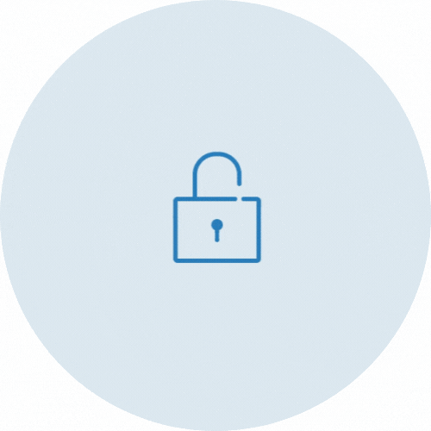
Nayan Patel
DEVICE HARDENING
02
Passwords
  One of a variety of measures
    Multi Factor Authentication
    Username and Password
  Policy
    Enforce stronger passwords
    Change passwords frequently
  Keyloggers
    Protection
Notes:
Password hardening is one of a verity of measures taken to make it more difficult for an attacker to find their way around the authentication process. This can be hardened further by enabling two factor authentication and by adding user accounts.
A policy-based password hardening involves enforcing stronger passwords and requiring users to change them more frequently
A disadvantage of this, are keyloggers. A company has developed a method of password hardening that presents the user with a new image of a scrambled keyboard for each login, and the user clicks the password with the mouse.

Slide 3


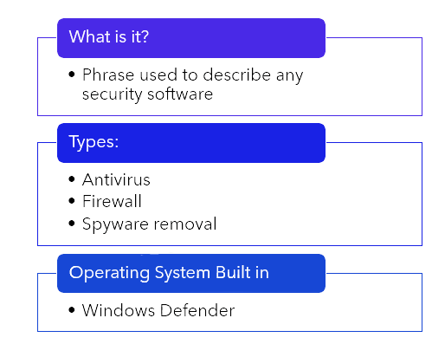

Nayan Patel
DEVICE HARDENING
03
Security Software
Notes:
System software is a general phrase used to describe any software that provides security for a computer or network. There are many types of security software such as antivirus, firewall software and spyware removal software.
Some operating systems come with preloaded security software and tools such as windows.

Slide 4
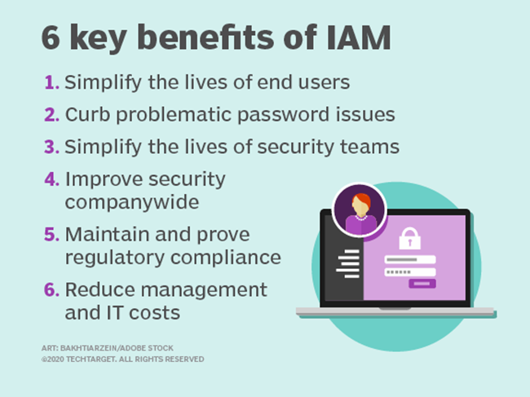

Nayan Patel
DEVICE HARDENING
04
User accounts (IAM system)
Identity and Access Management
1
  An account for everyone
Everyone's information is stored separately
2
  Simple for users
  Access wherever they are
3
  Only see what you need
  Locked down
4
  Reduce costs
  Less password reset calls
Notes:
IAM systems enable people to access systems regardless of where they are, what time and what device they're using. This is simple for users and more secure as data will not be shared between everyone who logs into the system. IT administrators have the permission to allow and deny access to systems that the user doesn't need, this also helps with security.

Slide 5


Nayan Patel
DEVICE HARDENING
05
Group Policies
Benefits
Limitations
  Efficient management
  Ease of administration
  Password policy enforcement
  Run sequentially
  Limited triggers
Notes:
Group policies provide centralized management and configuration of operating systems, applications and user settings.
The benefits are more efficient management, ease of administration and password policy enforcement.
The limitations are that it runs one after another. And the limited triggers, they can only be applied at start up, when a user logs on or at set intervals.

Slide 6


Nayan Patel
DEVICE HARDENING
06
Software Updating
  Software updates offer many benefits
  Patch security flaws
  Protect your data
  People around you
Notes:
Software updating helps with a range of things
Updates may include repairing security holes and fixing or removing computer bugs.
Updates can help patch security flaws
Hackers can take advantage of a security flaw and write code to target the machine.
Updates help to protect your data
Hackers can use your data to commit crimes in your name or sell it on the dark web to enable others to commit crimes.
Updating your device protects people around you
If your device gets a virus, you could pass it on to your friends, family, and business associates.

Slide 7

The end. Say bye to all the secure people
Notes:
End slide

